Slide 1

Explainable AI Framework for Employee Attrition Prediction
Project Team
Mahith 2420090095
Ch. Charan Teja 2420090022
G. Nishanth 2420030679
Moksha 2400090182
Course Coordinator : Dr. K. Swanthana mam
Team :16
Course code : 24ALT3101
01

Slide 2
Problem Statement
◆ Employee attrition is a major challenge for organizations because it increases recruitment costs, reduces productivity and creates difficulties in retaining skilled employees.
◆ Traditional machine learning systems generally predict whether an employee is likely to leave, but often provide limited transparency about the reason behind the prediction.
◆ HR managers need a system that not only identifies employees at risk, but also explains the factors influencing that risk.
◆ Our project proposes an Explainable AI framework to make attrition predictions transparent and actionable.
02

Slide 3
Objectives
◆ To Develop a Framework, utilizing machine learning model to predict whether an employee is likely to leave the organization.
◆ To improve model generalizability by evaluating the framework using appropriate datasets and validation approaches.
◆ To integrate Explainable AI techniques to provide transparent explanations for individual employee attrition predictions.
◆ To identify the key factors contributing to employee attrition and provide actionable insights for reducing employee turnover.
◆To enhance prediction reliability by addressing class imbalance and evaluating model performance using suitable metrics.
03

Slide 4
Literature Survey
Research Paper | Techniques Used | Purpose | Limitation
IBM Employee Attrition Analysis — Yang & Islam (2020) (arXiv) | Correlation Matrix, Random Forest, K-Means Clustering, Logistic Regression | To identify the major factors influencing employee attrition and analyze why employees leave an organization. | Uses a single IBM dataset, so the findings may have limited generalizability to other organizations.
Predict Employee Attrition Using Multiple Machine Learning Techniques — Ghanem & Al-Alawi (2024) (DOI) | Random Forest, XGBoost, Decision Tree, Bernoulli Naive Bayes, KNN, SVM, Logistic Regression, Oversampling, GridSearchCV | To compare multiple ML algorithms and identify the most effective model for employee attrition prediction. | Dataset has class imbalance and the results may not generalize well to other organizations; more datasets are needed.
Employee Attrition Prediction using Machine Learning: A Data-Driven Approach for Workforce Analytics (2025) (DOI) | Logistic Regression, Gradient Boosting, Random Forest, SVM, Gaussian Naive Bayes, Feature Engineering | To predict employee attrition and identify important employee characteristics that can help HR managers develop retention strategies. | The study is primarily focused on prediction and model comparison; broader real-world validation is still needed.
A Stacking Ensemble Framework for Predicting Employee Turnover: Explainable AI with SHAP — Rahman et al. (2025/2026 publication record) (EurekaMag) | Machine Learning, Ensemble Learning, Deep Learning, Stacking, SHAP | To predict employee turnover using ensemble approaches and explain the model's predictions using SHAP. | Relies on the IBM HR Analytics dataset, which limits generalizability to different organizations and workforce environments.
Integrating Machine Learning and Explainable AI for Employee Attrition Prediction in HR Analytics (2026) (DOI) | Machine Learning, SHAP, Feature Selection, Data Balancing, Hyperparameter Optimization | To combine accurate attrition prediction with explainable AI so HR teams can understand the factors behind predictions. | Synthetic datasets such as IBM HR Analytics may not represent real-world organizations; SHAP may not fully capture complex feature interactions.
04

Slide 5
Research Paper | Techniques Used | Purpose | Limitation
Employee Attrition Prediction Using Bayesian Optimized Stacked Ensemble Learning and Explainable AI — Konar et al., 2025 | Stacking, XGBoost, Random Forest, Bayesian Optimization, SHAP, LIME | To improve attrition prediction and explain why employees are predicted to leave. | Mainly evaluated on benchmark data; broader organizational validation is still needed. (Springer)
Integrating Machine Learning and Explainable AI for Employee Attrition Prediction in HR Analytics — Al-Ali et al., 2026 | Adaptive Boosting, Histogram Gradient Boosting, SHAP, feature selection, data balancing | To combine accurate attrition prediction with explainability, fairness and actionable HR insights. | Existing HR datasets may not fully represent different real-world organizations. (PubMed Central (PMC))
Explainable AI for Employee Turnover Prediction: A SHAP-Based Intelligent Analytics Approach — Haojie Jia, 2026 | XGBoost, Random Forest, LightGBM, Logistic Regression, SHAP, SMOTE, fairness audit | To provide global, local and interaction-based explanations for employee turnover predictions. | Feature importance and subgroup effects can vary between datasets, requiring validation for each deployment. (Nature)
Predicting Employee Attrition: XAI-Powered Models for Managerial Decision-Making — 2025 | Transformer, GAN-based oversampling, SHAP | To handle class imbalance and provide transparent attrition predictions for HR managers. | Authors identify the need for validation across more industries and lightweight real-time implementation. (MDPI)
Employee Attrition Prediction: An Explanatory and Statistically Robust Ensemble Learning Model — 2026 | SHAP, LIME, Optuna, Random Oversampling, Ensemble Learning | To combine accurate prediction with global and local explanations and identify important retention factors. | Uses benchmark datasets, so real-world organizational validation remains important. (MDPI)

Slide 6
Research Gap Identification
Limited Generalizability: Most studies rely heavily on the IBM HR Analytics dataset, making it difficult to confirm whether the models perform effectively across different organizations and workforce environments.
Limited Explainability: Several existing approaches focus primarily on prediction accuracy and model comparison, without providing sufficient explanations for individual employee predictions.
Lack of Actionable Insights: Existing models mainly identify employees who are likely to leave but provide limited guidance on which factors should be addressed to reduce attrition.
Class Imbalance Challenge: Employee attrition datasets often contain significantly fewer employees who leave compared with those who stay, which can affect prediction performance.
Limited Real-World Validation: Many approaches are evaluated on benchmark or synthetic datasets rather than validated using diverse real-world organizational data.
05

Slide 7
Innovation
◆ Integrates machine learning-based attrition prediction with Explainable AI.
◆ Provides understandable explanations for individual employee risk predictions.
◆ Identifies important employee attributes contributing to the predicted outcome.
◆ Supports aggregate analysis to identify departments with high attrition rates.
◆ Can reveal recurring causes, workforce trends and areas requiring management attention.
06

Slide 8
Creativity & Novelty
◆ Creativity: Converts complex machine learning decisions into information that can be understood by HR personnel.
◆ Novelty: Combines individual prediction, prediction confidence and explainability within one framework.
◆ Uses multiple possible explanation approaches such as SHAP, LIME, feature importance and permutation importance.
◆ Extends the analysis from individual employees to department-level workforce patterns.
◆ Focuses on producing actionable insights rather than only a binary prediction.
07

Slide 9
Feasibility
◆ Technical feasibility: The project uses established supervised machine learning and Explainable AI techniques.
◆ Data feasibility: The IBM HR Analytics Employee Attrition dataset is identified as a benchmark dataset in the project.
◆ Implementation feasibility: Data preprocessing, model training, evaluation and visualization can be implemented using Python-based tools.
◆ Evaluation feasibility: Accuracy, precision, recall, F1-score, ROC-AUC and confusion matrix can be used for model evaluation.
◆ Project scope is suitable for an academic implementation and can be extended with a dashboard or interface.
08

Slide 10
Project Plan
◆ Phase 1 — Literature survey & requirements
◆ Phase 2 — Dataset collection & preprocessing
◆ Phase 3 — EDA & feature engineering
◆ Phase 4 — ML model development
◆ Phase 5 — Explainable AI integration
◆ Phase 6 — Model evaluation
◆ Phase 7 — Interface/dashboard development
◆ Phase 8 — Testing, documentation & presentation
11

Slide 11
Review 2
15

Slide 12
Methodology
Data Collection – The IBM HR Analytics Employee Attrition Dataset is collected for employee attrition analysis.
Data Preprocessing – The dataset is cleaned by handling unnecessary data and encoding categorical variables into numerical form.
Feature Engineering – Relevant employee attributes are selected and prepared as input features for the machine learning model.
Train–Test Split – The dataset is divided into training and testing data to train the model and evaluate it on unseen data.
SMOTE – Synthetic Minority Over-sampling Technique is applied only to the training data to address class imbalance between Leave and Stay employees.
XGBoost Model – The XGBoost classification model is trained using the processed and balanced training data to predict employee attrition.
Prediction – The trained model predicts whether an employee is likely to Leave or Stay and provides a risk probability.
Explainable AI – LIME and SHAP are used to explain the factors contributing to individual employee attrition predictions.
Performance Evaluation – The model is evaluated using Accuracy, Precision, Recall, F1-Score, ROC-AUC, and Confusion Matrix.
15

Slide 13
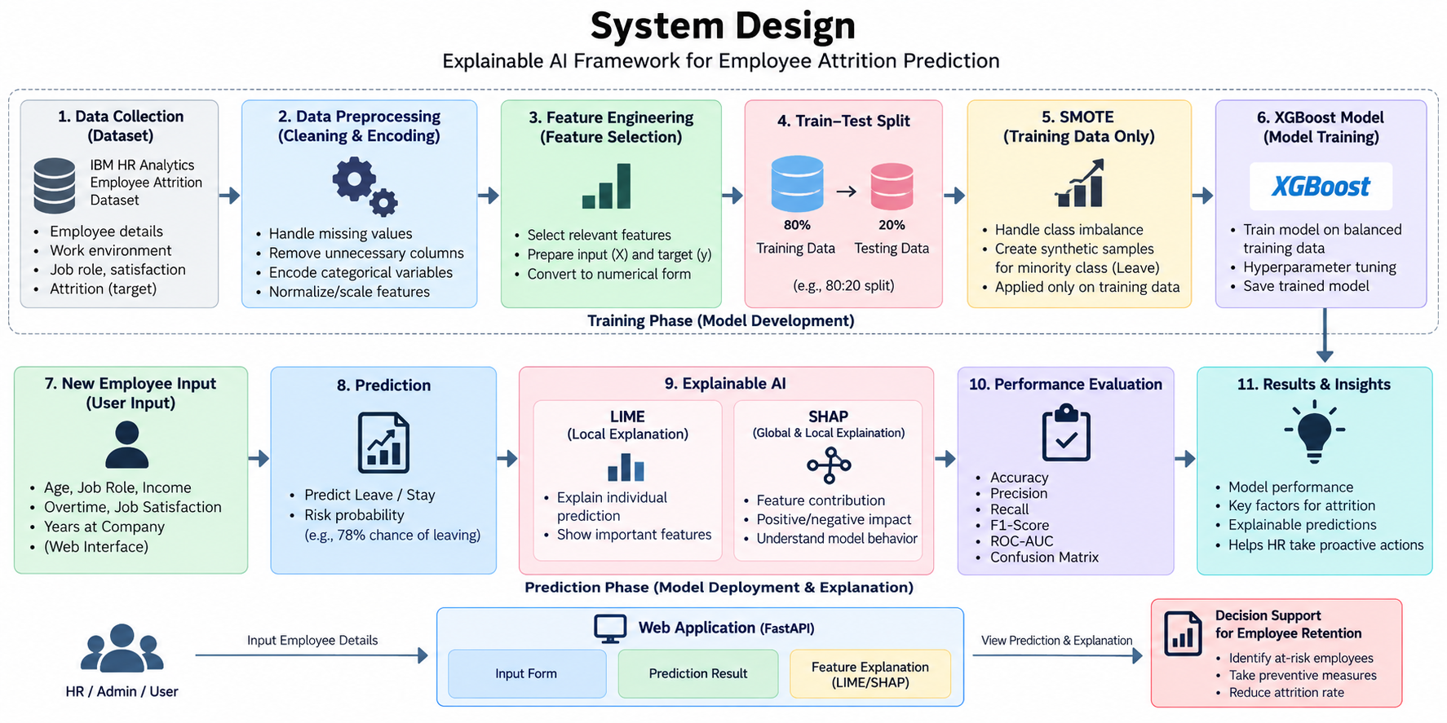
System Design
Employee
Input
Frontend
HTML/CSS/JS
FastAPI
Backend
Data Preprocessing
XGBoost
Model
Risk +
Probability
SHAP + LIME
Explanation
Final Result
shown on website
15

Slide 14
Modern Tools and Technologies
Technology stack used in the current project
Python
Pandas / NumPy
Scikit-learn
XGBoost
Core application and ML development
Dataset processing and numerical operations
Preprocessing, split and evaluation
Primary employee attrition classifier
SHAP
LIME
FastAPI + Uvicorn
HTML / CSS / JavaScript
Global and individual model explanations
Local explanation for individual predictions
Backend API and local server
User-facing frontend and API integration

Slide 15
Implementation
• Existing frontend collects employee attributes.
• FastAPI receives employee input through the prediction API.
• Training preprocessing is reused for new employee data.
• XGBoost generates Attrition prediction and risk probability.
• LIME & SHAP provides an explanation.
• SMOTE is applied only during model training.
• Evaluation is performed on the untouched unseen test set.
• Evaluation metrics are displayed on the existing result page.
15

Slide 16
Code
# Predict employee attrition
risk = float(
pipeline.predict_proba(row)[0, 1]
)
prediction = (
"Likely to leave"
if risk >= 0.5
else "Likely to stay"
)
# SHAP explanation
values = shap.TreeExplainer(
pipeline.named_steps["model"]
)(
pipeline.named_steps["preprocess"].transform(row)
).values[0]
# LIME explanation
explanation = _lime.explain_instance(
transformed[0],
predict_fn,
num_features=8
)
# Split data first
X_train, X_test, y_train, y_test = train_test_split(
X, y, test_size=0.2,
random_state=42,
stratify=y
)
# Preprocess training data
X_train_processed = preprocess.fit_transform(X_train)
X_test_processed = preprocess.transform(X_test)
# SMOTE only on training data
smote = SMOTE(random_state=42)
X_train_smote, y_train_smote = smote.fit_resample(
X_train_processed, y_train
)
# Train XGBoost
model = XGBClassifier(
n_estimators=250,
max_depth=4,
learning_rate=0.05,
random_state=42
)
model.fit(X_train_smote, y_train_smote)

Slide 17
#model evaluation
from sklearn.metrics import (
accuracy_score,
precision_score,
recall_score,
f1_score,
roc_auc_score,
confusion_matrix
)
y_pred = model.predict(X_test)
y_prob = model.predict_proba(X_test)[:, 1]
accuracy = accuracy_score(y_test, y_pred)
precision = precision_score(y_test, y_pred)
recall = recall_score(y_test, y_pred)
f1 = f1_score(y_test, y_pred)
roc_auc = roc_auc_score(y_test, y_prob)
cm = confusion_matrix(y_test, y_pred)
@app.post("/api/predict")
def predict_employee(data: EmployeeInput):
employee_df = pd.DataFrame([data.dict()])
prediction = model.predict(employee_df)[0]
probability = model.predict_proba(employee_df)[0][1]
return {
"prediction": int(prediction),
"risk_probability": float(probability)
}
15

Slide 18
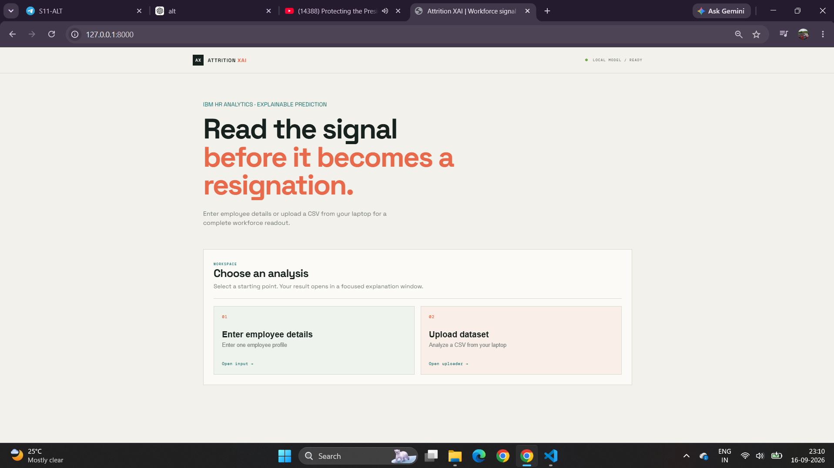
Results

Slide 19
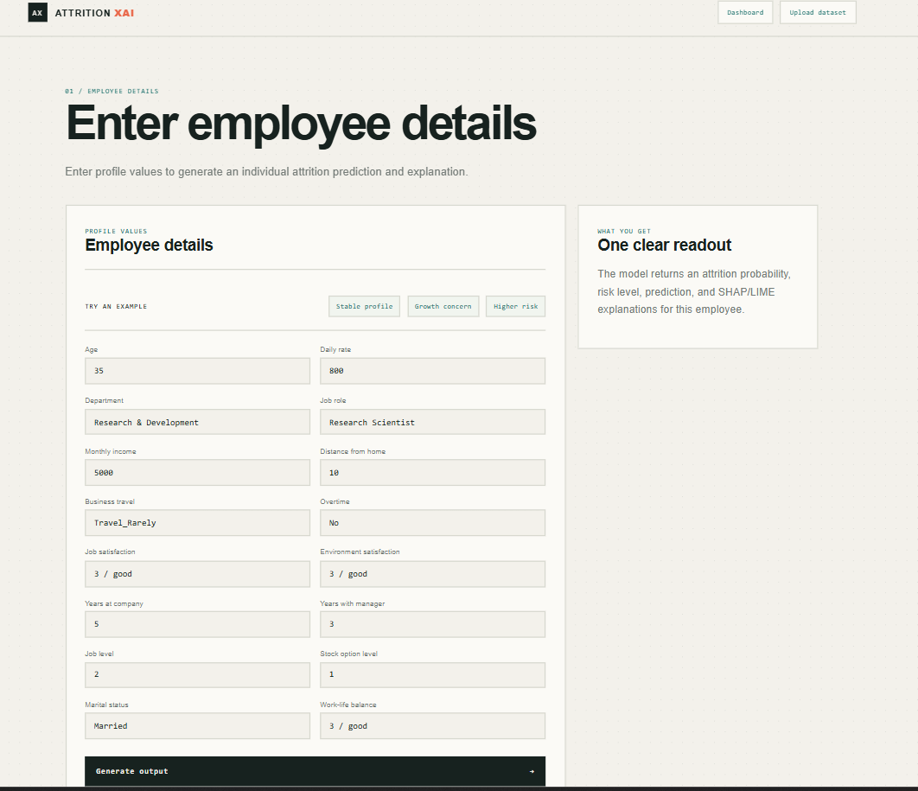
For Single Employee

Slide 20
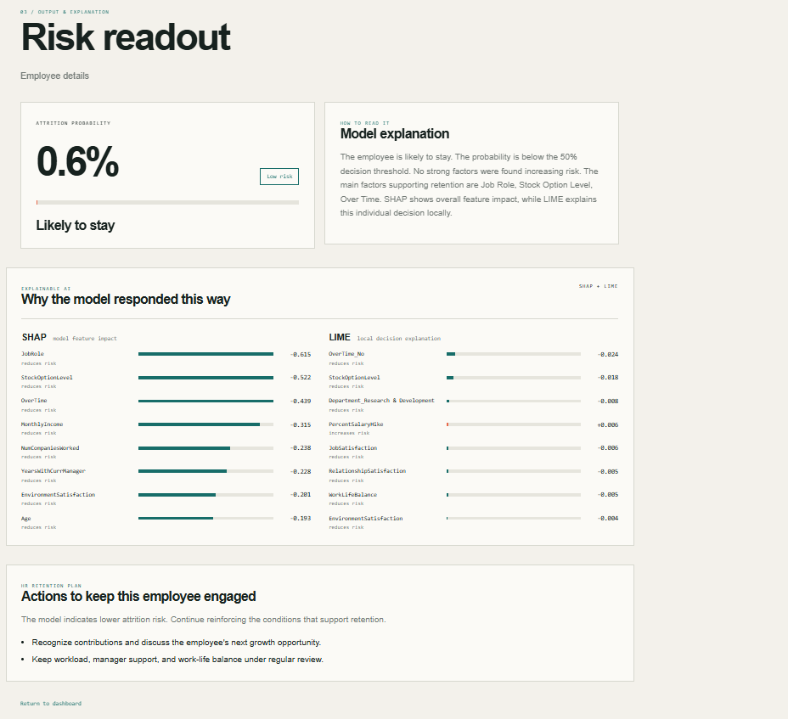

Slide 21
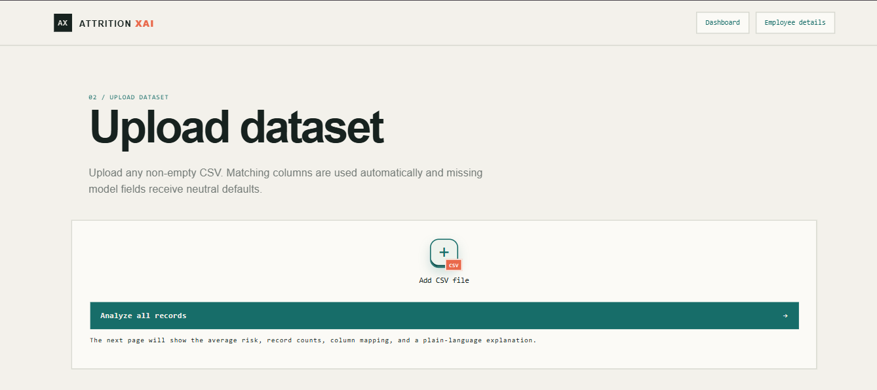
For Dataset

Slide 22
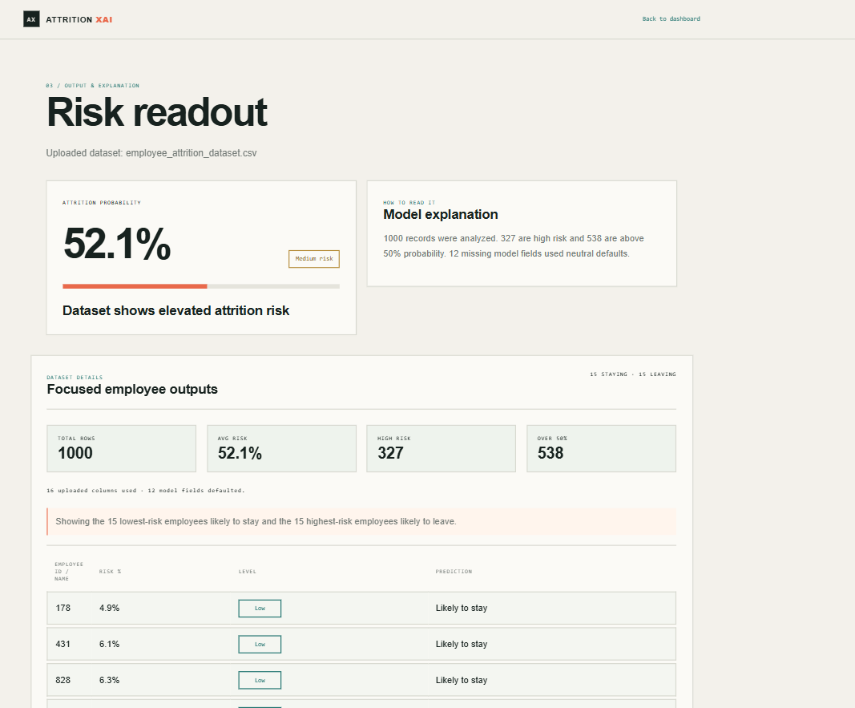

Slide 23
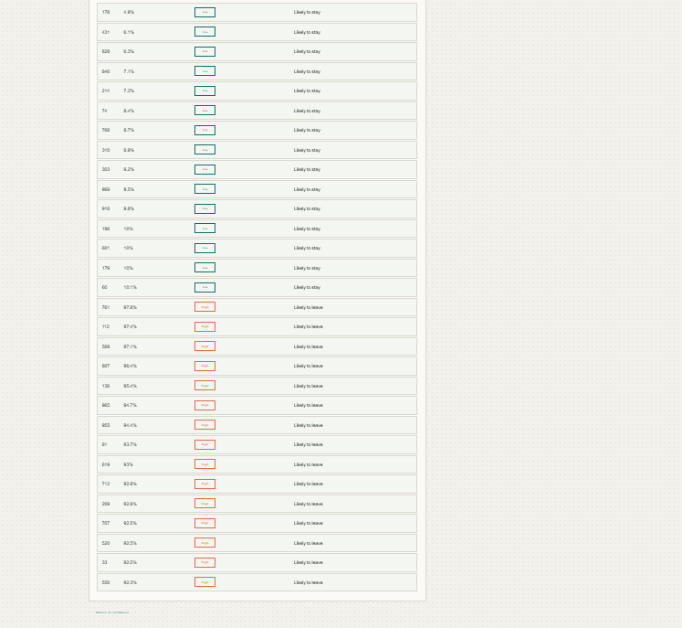
For dataset top 15 employes displayed
15

Slide 24
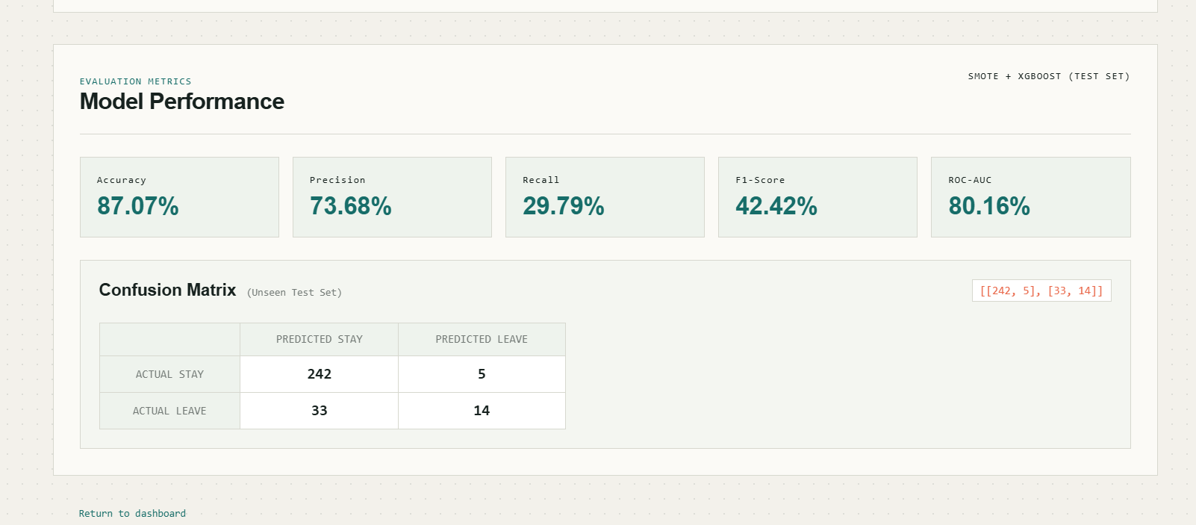
Performance Evaluation
15

Slide 28
System Design
Employee
Input
Frontend
HTML/CSS/JS
FastAPI
Backend
Data Preprocessing
XGBoost
Model
Risk +
Probability
SHAP + LIME
Explanation
Final Result
shown on website
15

Slide 29
Methodology
Data Collection
Datasets
Data Preprocessing
Cleaning & Encoding
Feature Engineering
Relevant Features
Train–Test Split
Training | Testing
SMOTE
Training Data Only
XGBoost Model
Model Training
Prediction
Leave / Stay + Risk
Explainable AI
LIME & SHAP
Performance
Evaluation
15

